Slide 1

LINEAR ALGEBRA PROJECT
TOPIC: VIRTUAL IMAGE DRAG AND DROP
TEAM MEMBERS:
NEERAJA N: PES2UG20CS528
RITHIKA A: PES2UG20CS539
S KUSHALA: PES2UG20CS541
SAKSHI DESHPANDE: PES2UG20CS544
SUMEDA PUJA:PES2UG20CS562

Slide 2
introduction
This project is about using open CV and media pipe libraries to utilize the web camera for Dragging and dropping images virtually.
The main idea is:
1)detect hands using media pipe.
2)detect index and thumb fingers' tip locations.
3) drag and drop the image from one place on the screen to another place virtually

Slide 3
LIBRARIES AND EXTENSIONS USED
OpenCV- is the most popular library for the task of computer vision, it is a cross-platform open-source library for machine learning, image processing, etc. using which real-time computer vision applications are developed.
Cv zone- is a computer vision package, where it uses OpenCV and Media Pipe libraries as its core that makes us easy to run like hand tracking, face detection, facial landmark detection, pose estimation, etc., and also image processing and other computer vision-related applications.
Media Pipe -is a Framework for building machine learning pipelines for processing time-series data like video, audio, etc.
Web camera

Slide 4
LINEAR ALGEBRA AND IMAGE PROCESSING
Digital Image Processing (DIP) and Linear Algebra (LA) go hand-in-hand. Digital images are made of pixels and each pixel contains numerical values that can be interpreted as the color in that part of the image.
When we have numbers, mathematical operations can be performed on them and this is where LA comes in. An image can be represented as a matrix and linear operations like matrix addition, subtraction, multiplication, etc., can be performed on them
Matrix representation of color images depends on the color system used by the program that is processing the image. For didactic purpose we will use the RGB (the most popular one), where each pixel specifies the amount of Red (R), Green (G) and Blue (B), and each colour can vary from 0 to 255. Thus, in the RGB, a pixel can be represented as a tri-dimensional vector (r, g, b) where r, g and b are integer numbers from 0 to 255.

Slide 5
Linear Algebra for Machine Learning using Python
Linear algebra is a pillar of machine learning. You cannot develop a deep understanding and application of machine learning without it.
Vectors: A Vector is the most fundamental building block of linear algebra.
Tensors: Tensors are a general extension to vectors. You may call a vector as a one-dimensional tensor, to begin with.

Slide 6
Where’s it used?
Neural Network → Matrix Operations
Dimensionality Reduction using PCA and Powers of Matrices → Eigenvalues
Multivariate Calculus and Probability → higher-order representation
Second-order Hessian Based optimization methods → Solving Ax=b

Slide 7
Linear Algebra in Open CV
Matrix Assignment and Cloning. In openCV, the assignment (“=”) operator does not copy a matrix. It only attaches a new ONE TO IT.
Accessing Sub-parts of Matrices. While working with matrices in OpenCV, we often need to access into a matrix partially.
Concatenation of Vectors into Matrix. Sometimes it is needed to concatenate multiple vectors into a matrix

Slide 8
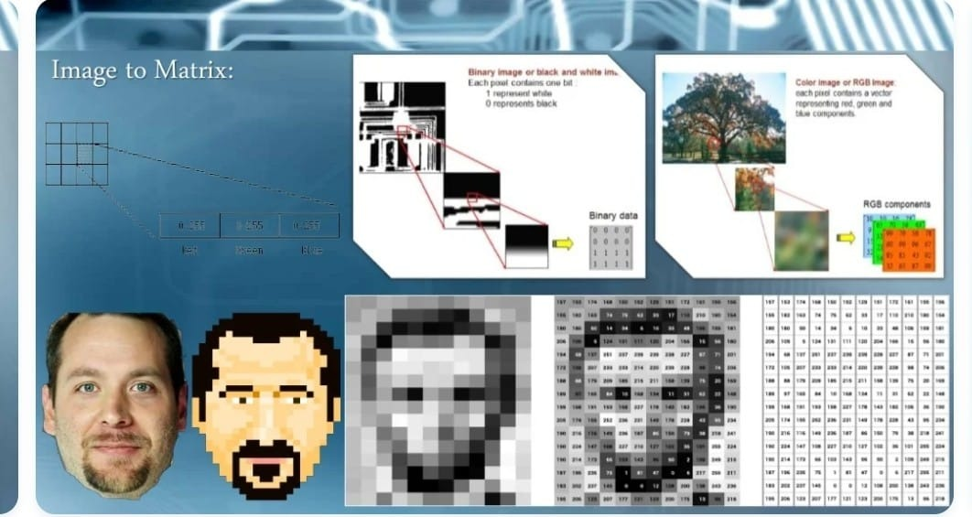

Slide 9
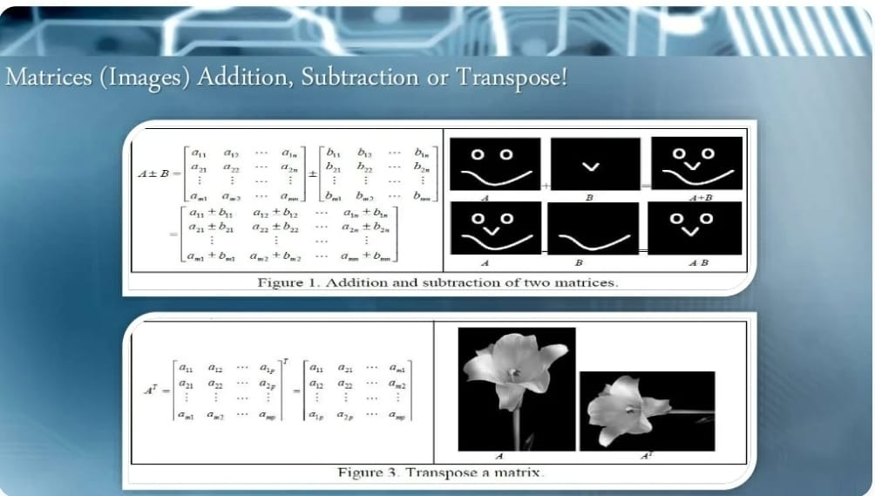

Slide 10
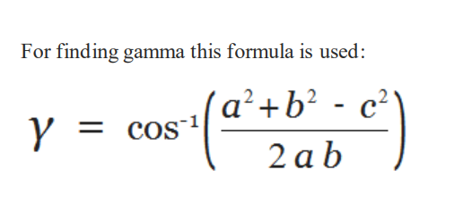
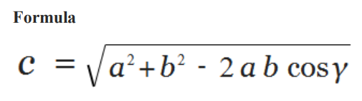
HOW LA IS USED TO RECOGNIZE HAND MOVEMENT?
In trigonometry, the law of cosines relates the lengths of the sides of a triangle to the cosine of one of its angles.
the law of cosines states where γ denotes the angle contained between sides of lengths a and b and opposite the side of length c.
By seeing this formula now we understand that if we have; a,b and gaama then we also find c as well as if we have; a,b,c then we also find gamma (vice-versa)

Slide 11
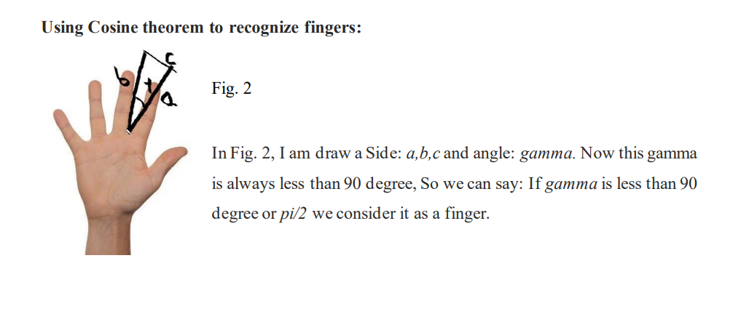

Slide 12
OUTPUT

Slide 13
THANK YOU

